Slide 1

Privilege Escalation Vulnerabilities Brought By Downloaded Apps
→Rishi Wadhwani
→Basundhara Dey

Slide 2
Introduction
Mobile phones are a vital part of all our lives today with their use ranging from the basic use of a phone such as making call all the way up to accessing secure data such as bank documents and details.
With the advancement of mobile phones and mobile applications, there also comes the need of higher security.
This project will cover the topic of how mobile applications leak out data or cause vulnerabilities due to privilege escalation

Slide 3
Approach
In our case, we would like to design a mobile application to demonstrate these how few of the downloaded apps cause security issues and gain elevated privileges.
Our app would be a simple app (most likely on the Android platform) that would carry out certain basic tasks but at the same time cause security issues.
Once we have demonstrated these vulnerabilities, our next step would be to try and change the app to one where the privilege escalation flaw can be prevented.

Slide 4
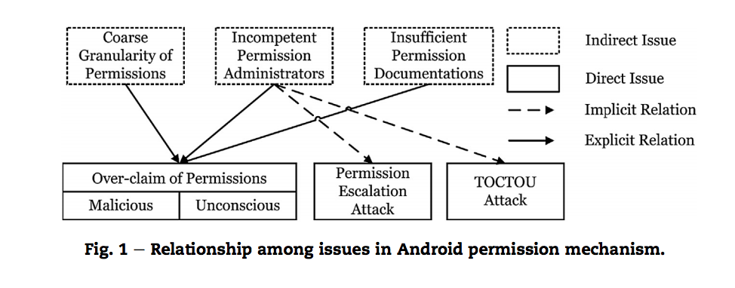
Issues in Android Permission Mechanism
TOCTOU Attack – Time of Check to Time of Use attack.

Slide 5
References
Xing, L., Pan, X., Wang, R., Yuan, K., & Wang, X. (2014). Upgrading Your Android, Elevating My Malware: Privilege Escalation Through Mobile OS Updating.
Fang, Z., Han, W., & Li, Y. (2014). Permission based Android security: Issues and countermeasures.
Geneiatakis, D., Fovino, I., Kounelis, I., & Stirparo, P. (2014). A Permission verification approach for android mobile applications.
Magdy, A., Mahros, M., & Hemayed, E. (2014). Firewall-based Solution for Preventing Privilege Escalation Attacks in Android.

